Slide 1
PDR-Application
Ahmad Abdel-Qader

Slide 2
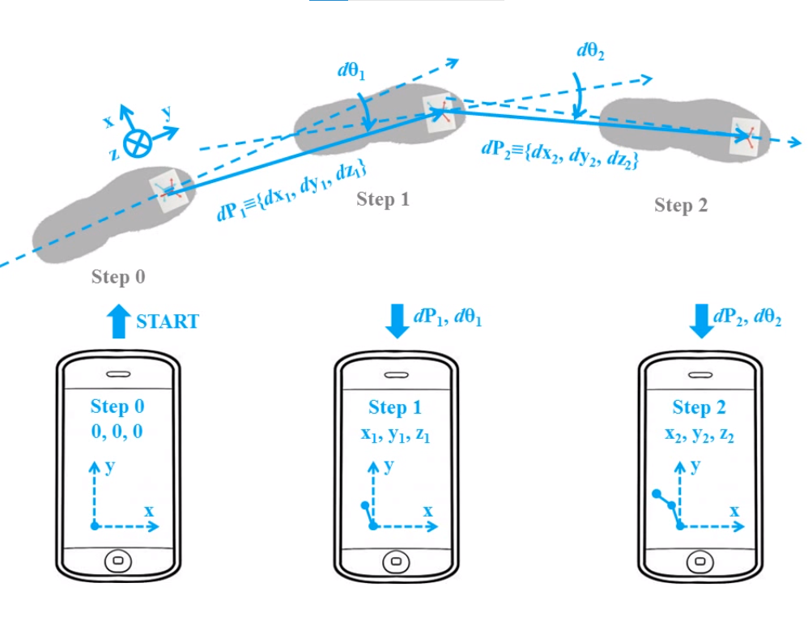
Overview
The app is capable to measure indoor positioning using IMUs, barometer and magnetometer.
It based on Pedestrian Dead Reckoning (PDR), detect the steps and project it on the moving direction. Then, construct the tracked path.
The app uses a floor detection algorithm to measure the user change in the floor number.

Slide 3
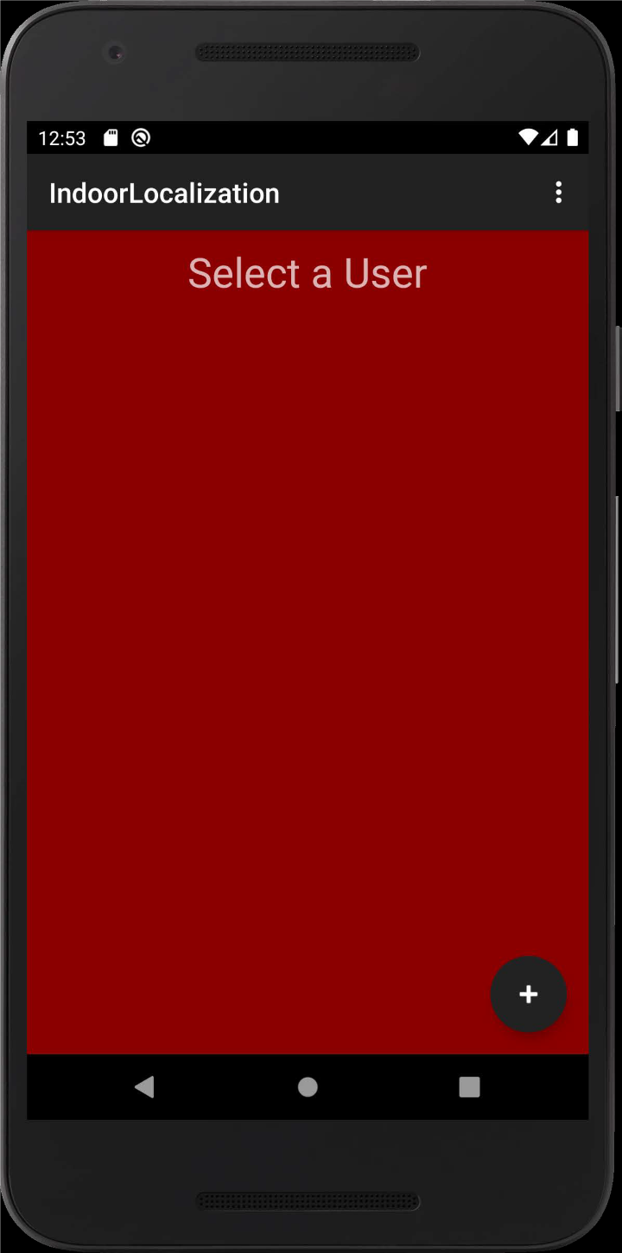
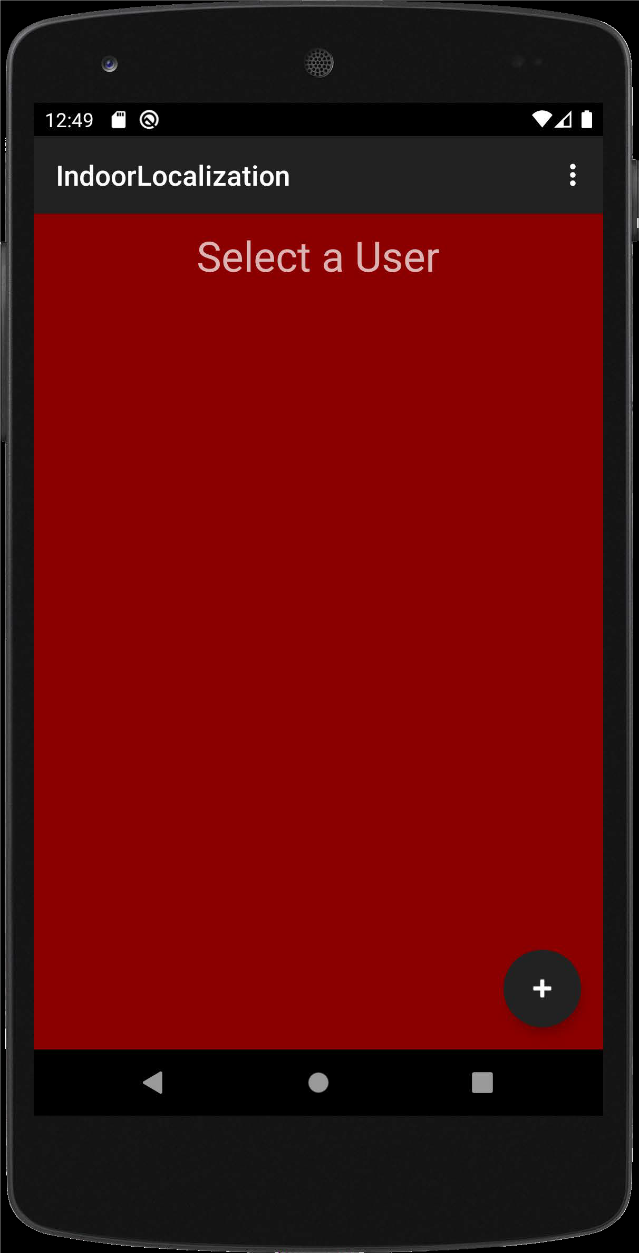
Application interface
The three dots on the upper right corner open the settings menu to adjust the filter parameters and change sensor frequency.
You can create a user to start the navigation process by clicking on the plus (+) button.
The tracked path is plotted in real time on the screen. The stride length and the total distance are shown in the top left corner.
All the raw data, gps, calibration values, tracked position in x and y, and the floor number (if supported) are saved in the CSV files.

Slide 4
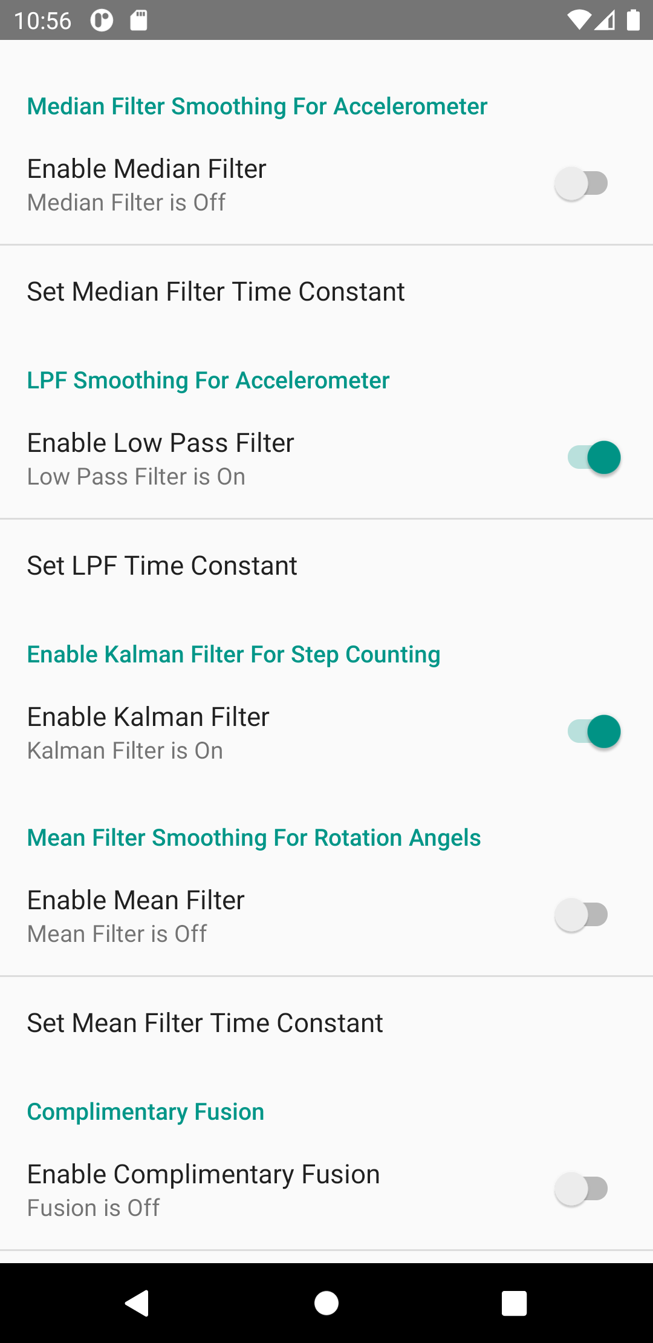
Setting menu
In the setting you can enable and disable the filters, this option made for debugging purpose, the best setting that used in the final result are already applied by default.
LPF time constant option have a direct impact on the step detection algorithm, by default its set to 0.5, decrease this number will increase the sensitivity of the algorithm.
[New] Added a GPS saving power mode.

Slide 5
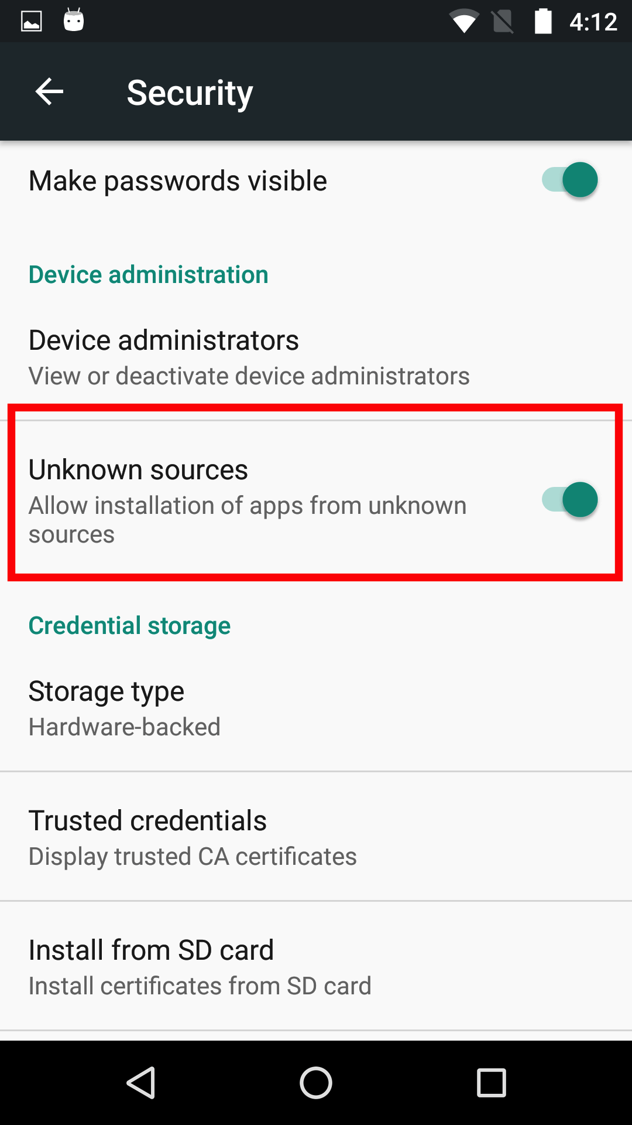
Install the app
Click on the APK file to install the app.
Make sure to enable installing apps from unknown sources. This option can be found in settings > security.
Give the App the required permissions from settings > Apps > Appname (IndoorLocalization) > permissions

Slide 6
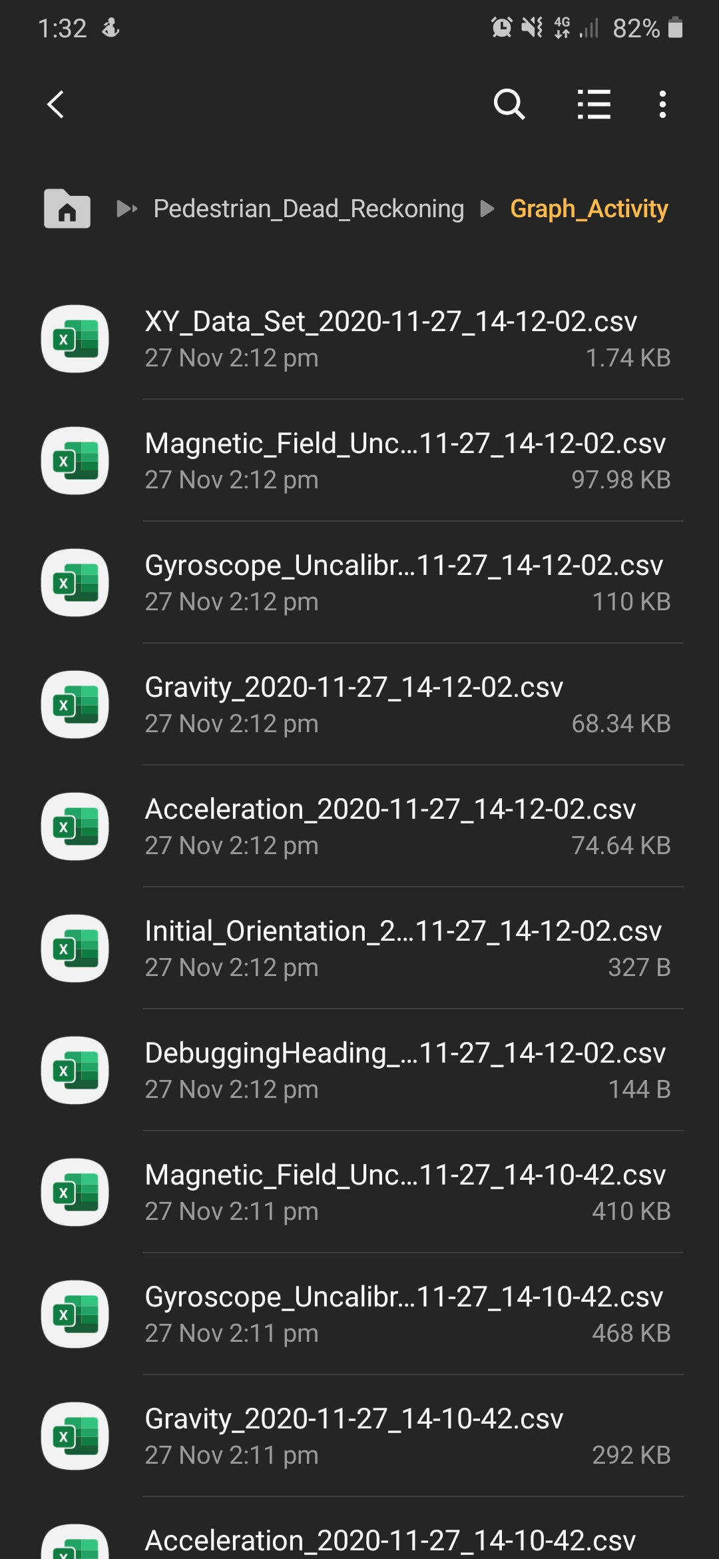
Saved data in the device storage
All data stored by the app can be found in device storage > Pedestrian_Dead_Reckoning > Graph_Activity.
Multiple CSV file will be stored in this directory, each file has some useful information such as raw_data from the sensors, time stamp, floor number, calculated calibration paprameters, and x,y displacment.
All CSV files are named such as (containedData_year_month_day_time).

Slide 7
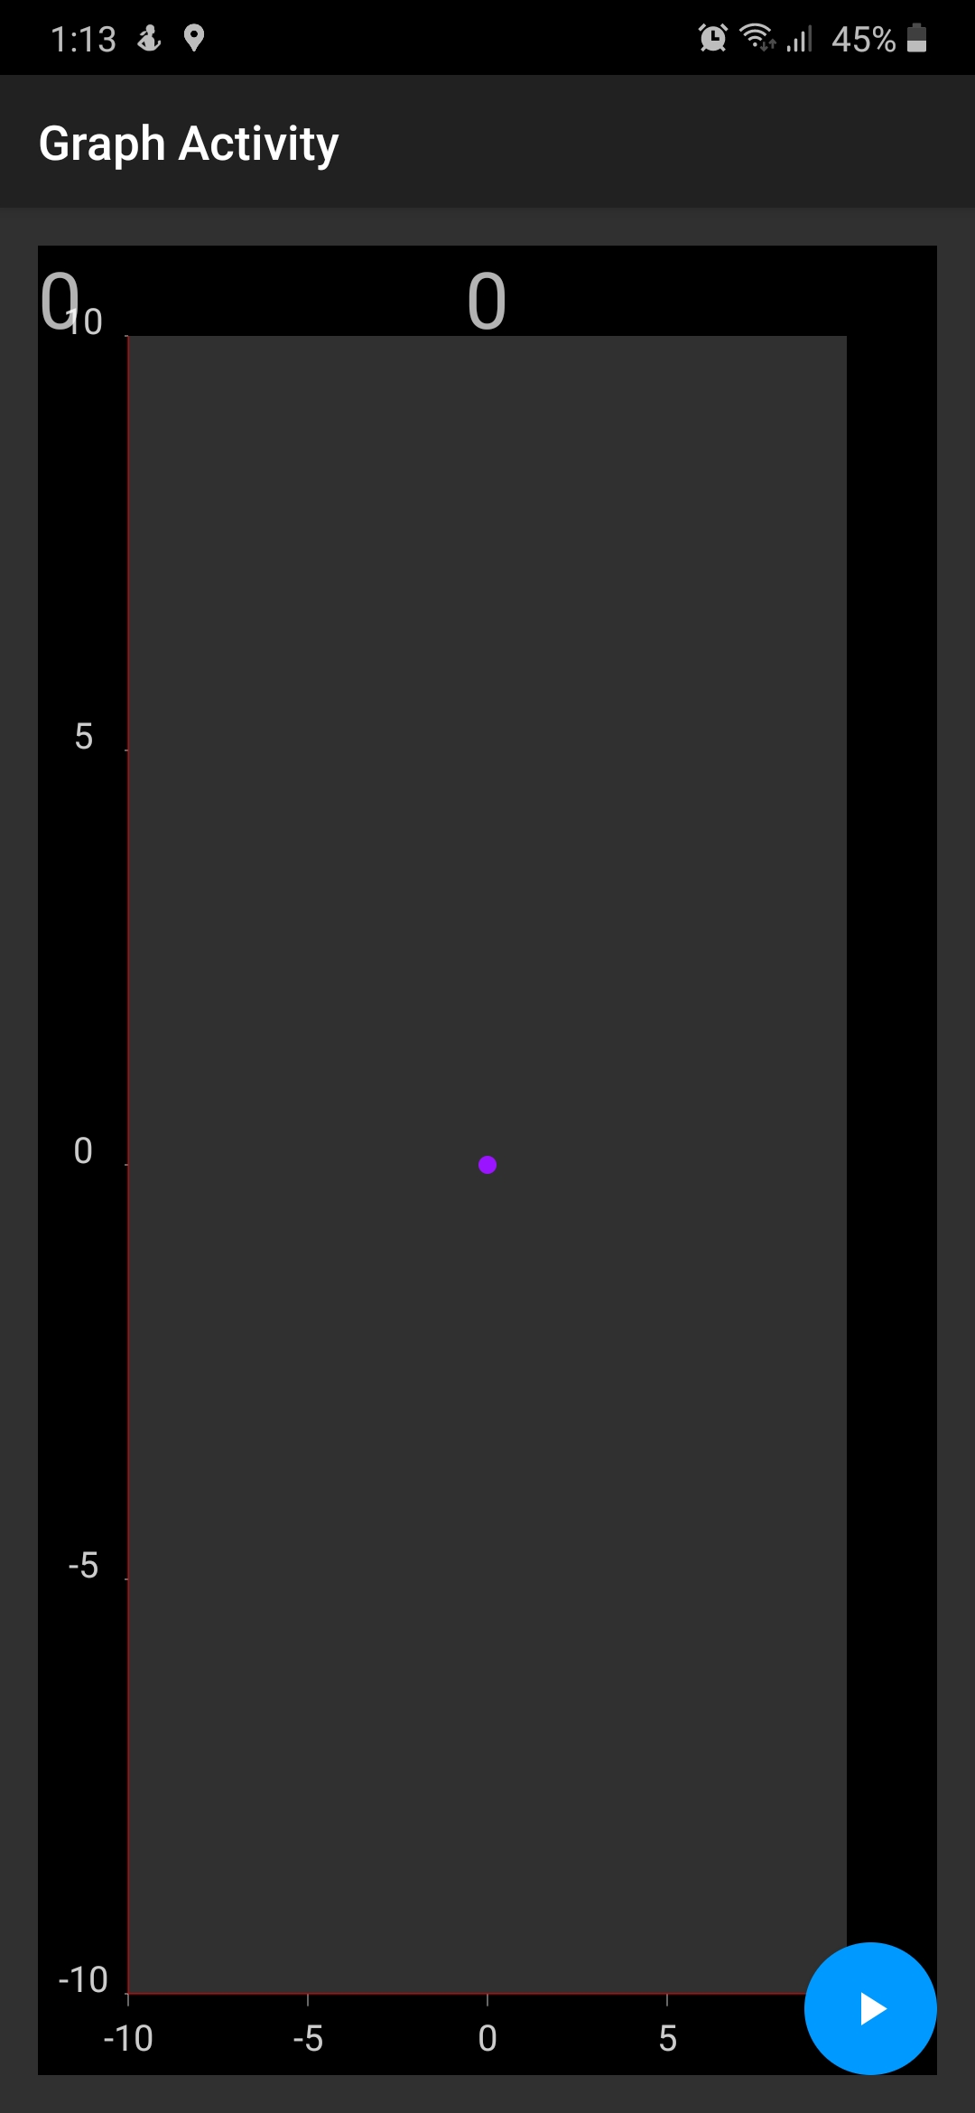
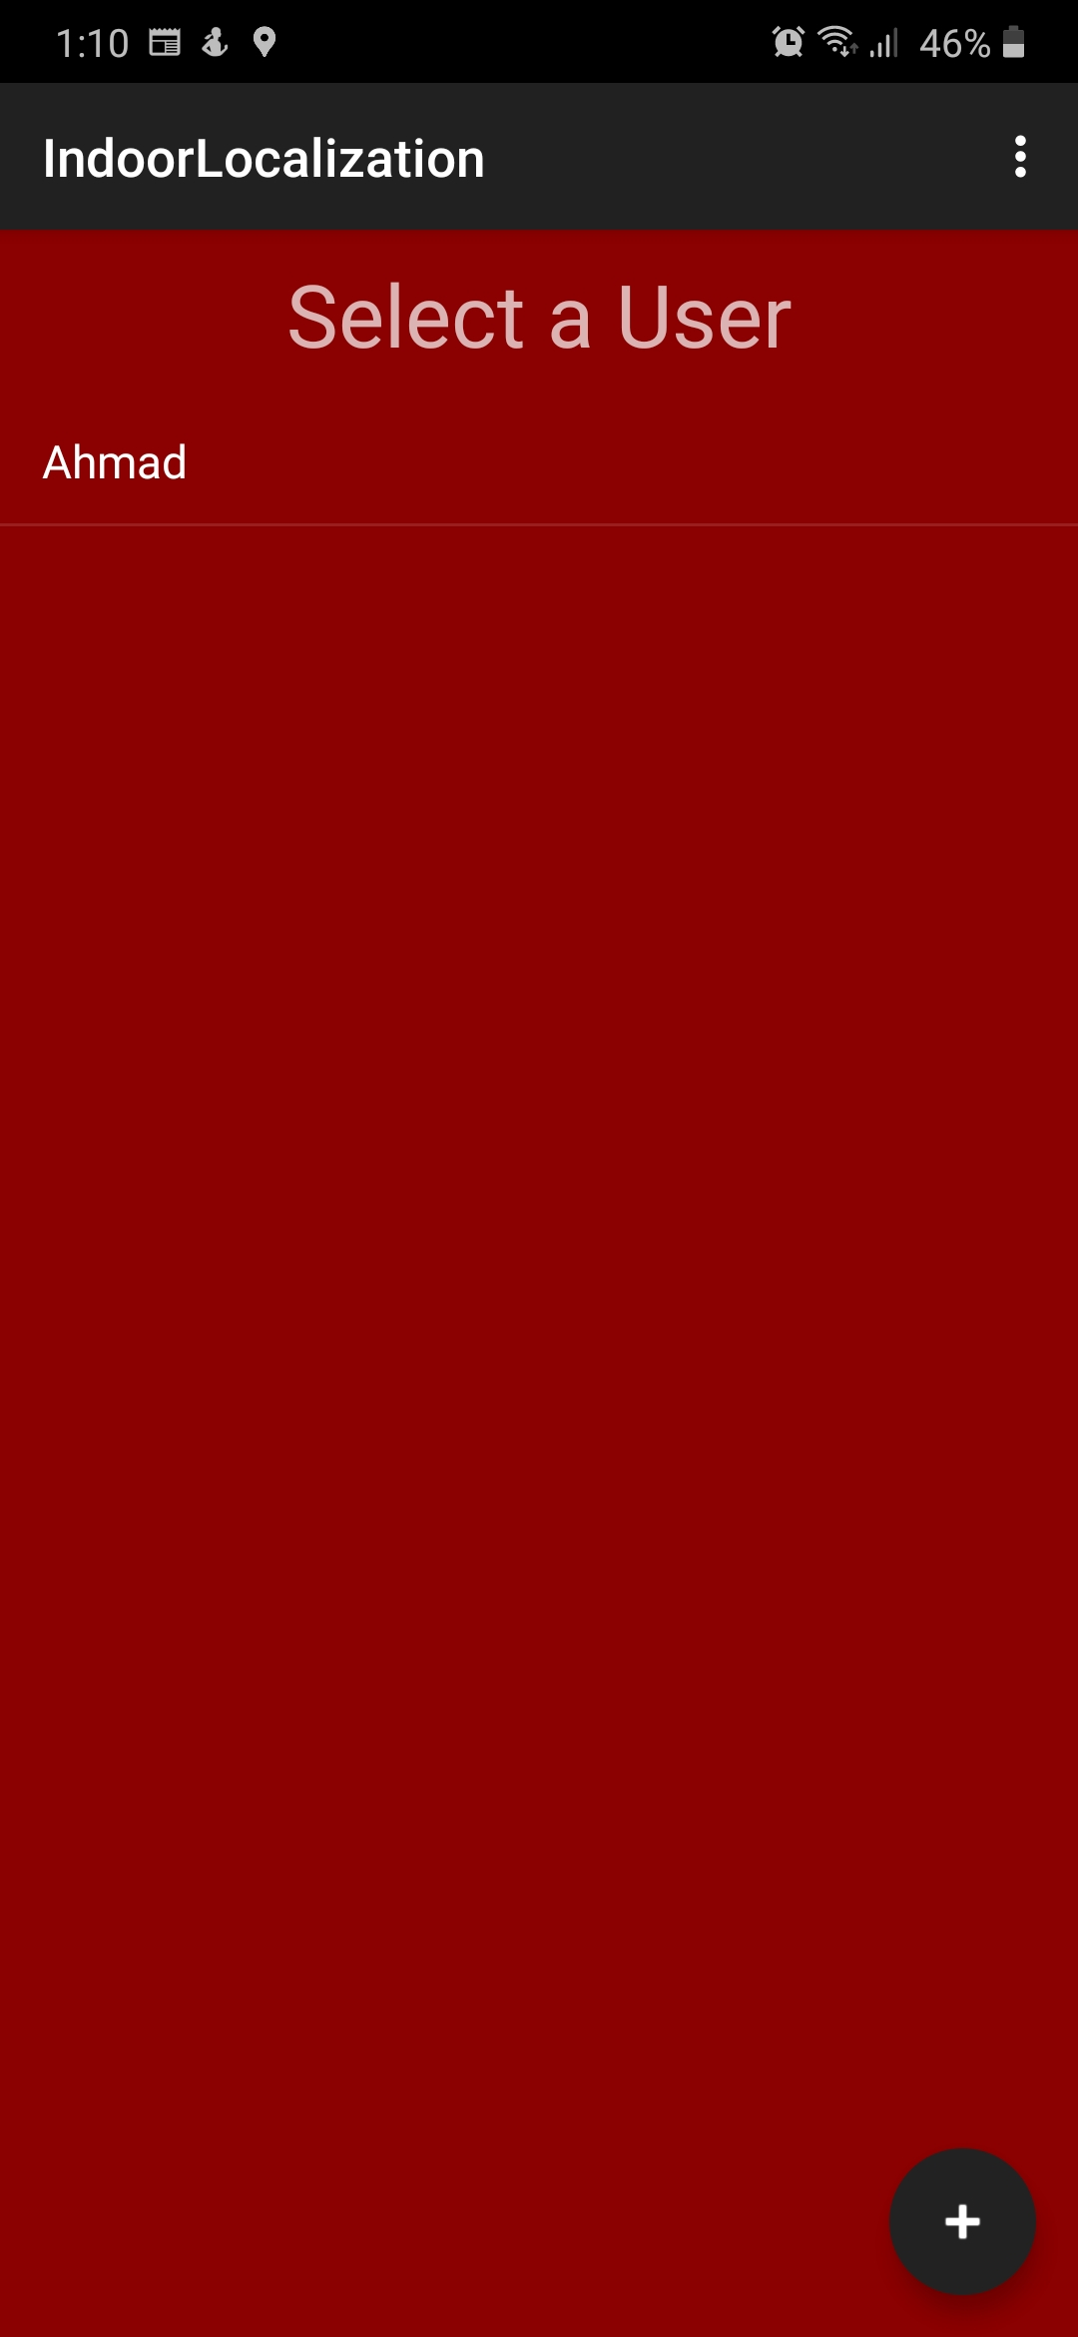
How to use it?
The app should have a permission to access phone storage (to store positioning details). Also, the app need access to physical activity to use hardware-based step counter (if available).
Click on the created username to start the positioning algorithm. As soon as the graph screen is shown the app will measure the true-north based on magnetometer readings.
Click on the blue button to start constructing the tracked path. Click again to pause the tracking system.

Slide 8
App limitations
If the smartphone doesn’t have a barometer, the floor detection algorithm won’t work.
The step detection algorithm is working good in handheld mode. On the other hand, if the phone in the pocket, for example, it’ll start missing steps.
Solution:
Most smartphones support hardware-based step detection algorithm, In the app, I give priority to use this feature if it’s supported, otherwise our step detection method will be used.
Some suggested smartphones with barometer and hardware-based step detection:
Google pixel, Samsung Galaxy S8 and above, Huawei Mate 40, Huawei P30

